Slide 1
SAT WeeK Show A talent!
11th – 14th May

Slide 2
This week should have been sats week… tests, tests, tests
To celebrate the fact that we don’t have to do the tests, Miss Riley and Miss Barker decided that SATs week should stand for Show A Talent.
If you want to take part, all you have to do is send in a video or photo via Google Classroom or email office@standrews.calderdale.sch.uk
Your talent can be whatever you like – singing, dancing, playing an instrument, hula-hooping, gymnastics, magic tricks, baking – the list is endless!
It’s all just for fun, so join in if you want to and Show A Talent in SATs Week!

Slide 3
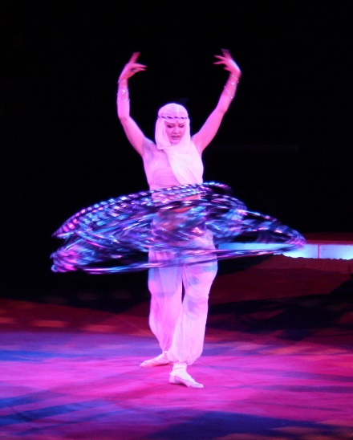
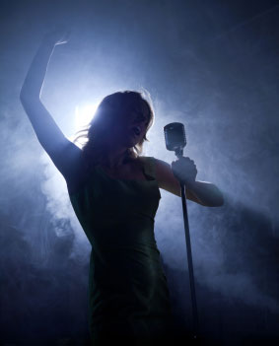
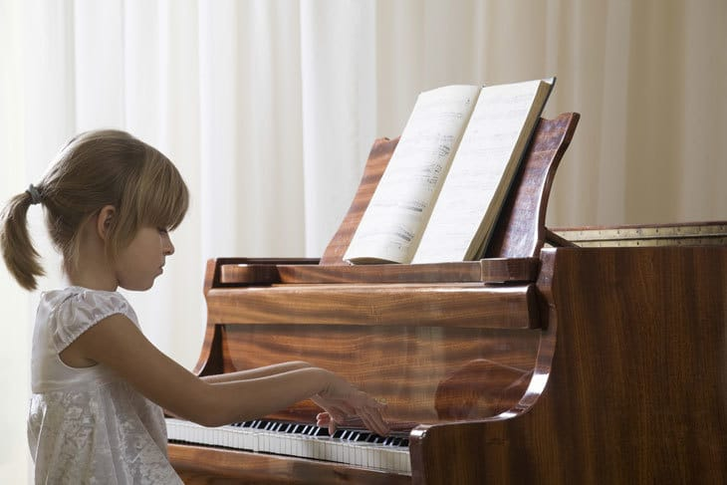
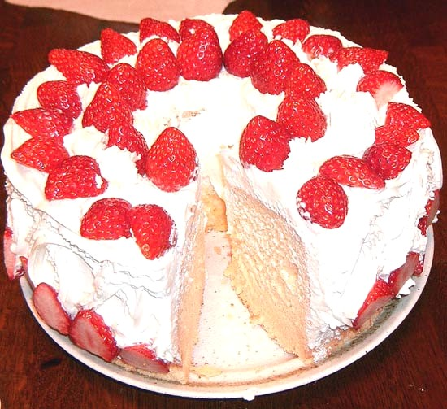
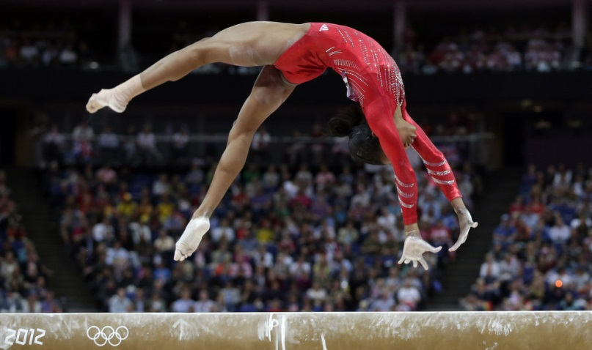
Show A talent!

